Slide 1


The City of Cincinnati’s Safe and Clean Neighborhood Fund
Ty Wesselkamper
Safe and Clean Grant Coordinator
Ty@KeepCincinnatiBeautiful.org

Slide 2
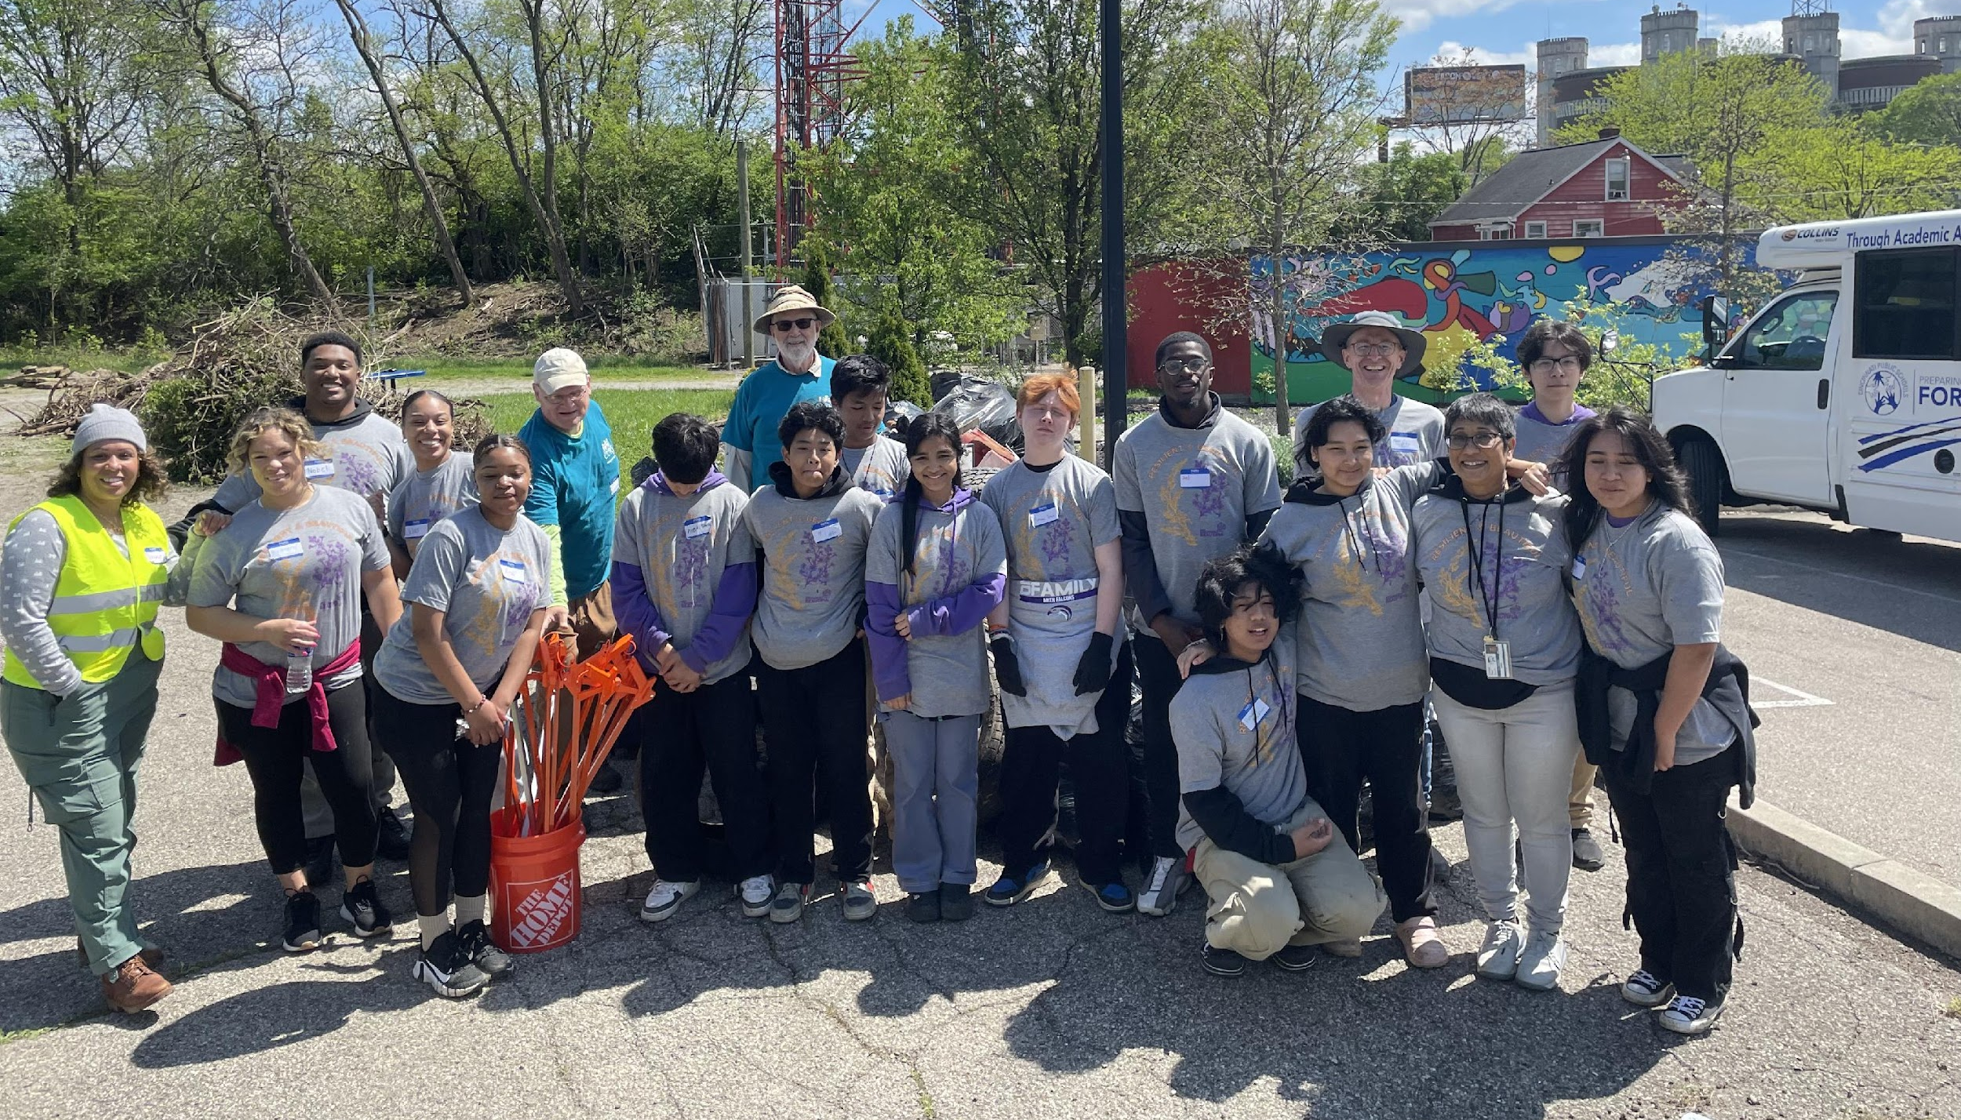
SAFE & CLEAN NEIGHBORHOOD FUND
Mt. Airy C.U.R.E and local volunteers prepping the community space in Mt. Airy's business district as part of their Safe and Clean Grant. The outdoor space will have an ADA path, family friendly seating, and a community garden.

Slide 3
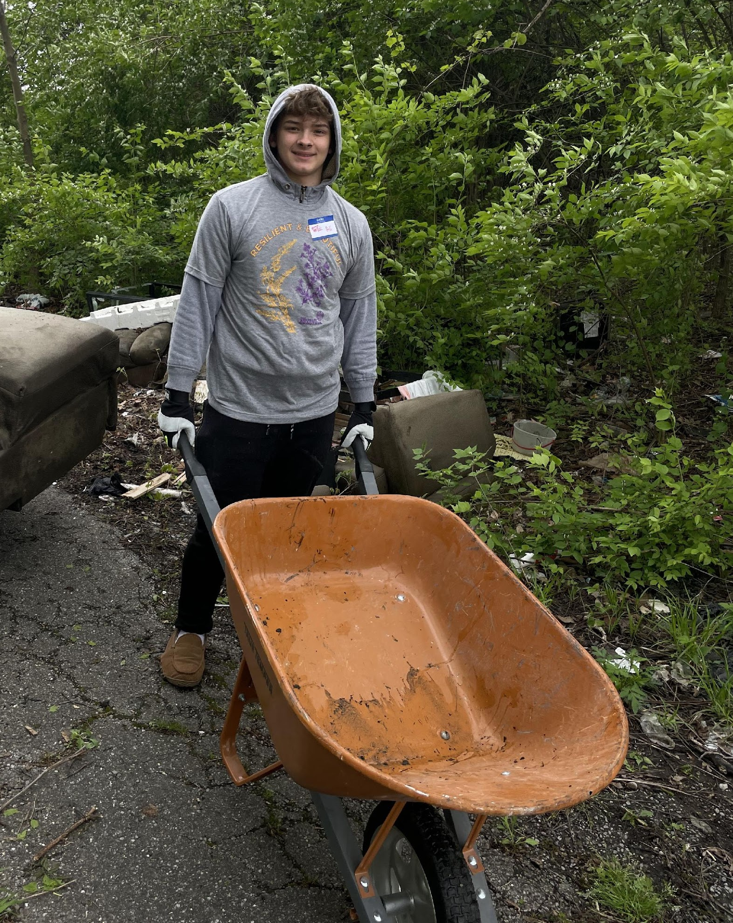
The goals of Safe and Clean Fund are to:
To support and encourage youth-led, community-based, and community-initiated projects(collaboration with other communities/organizations strongly encouraged)
To support projects that harness the power of young people to create lasting, positive changes in their communities.
To provide financial support for one-time costs (not ongoing operating expenses) for neighborhood-led initiatives to improve the quality of life within the City’s neighborhoods.
Volunteers came together to help Mt. Airy C.U.R.E remove litter and invasive plants at Mt. Airy's business district.

Slide 4
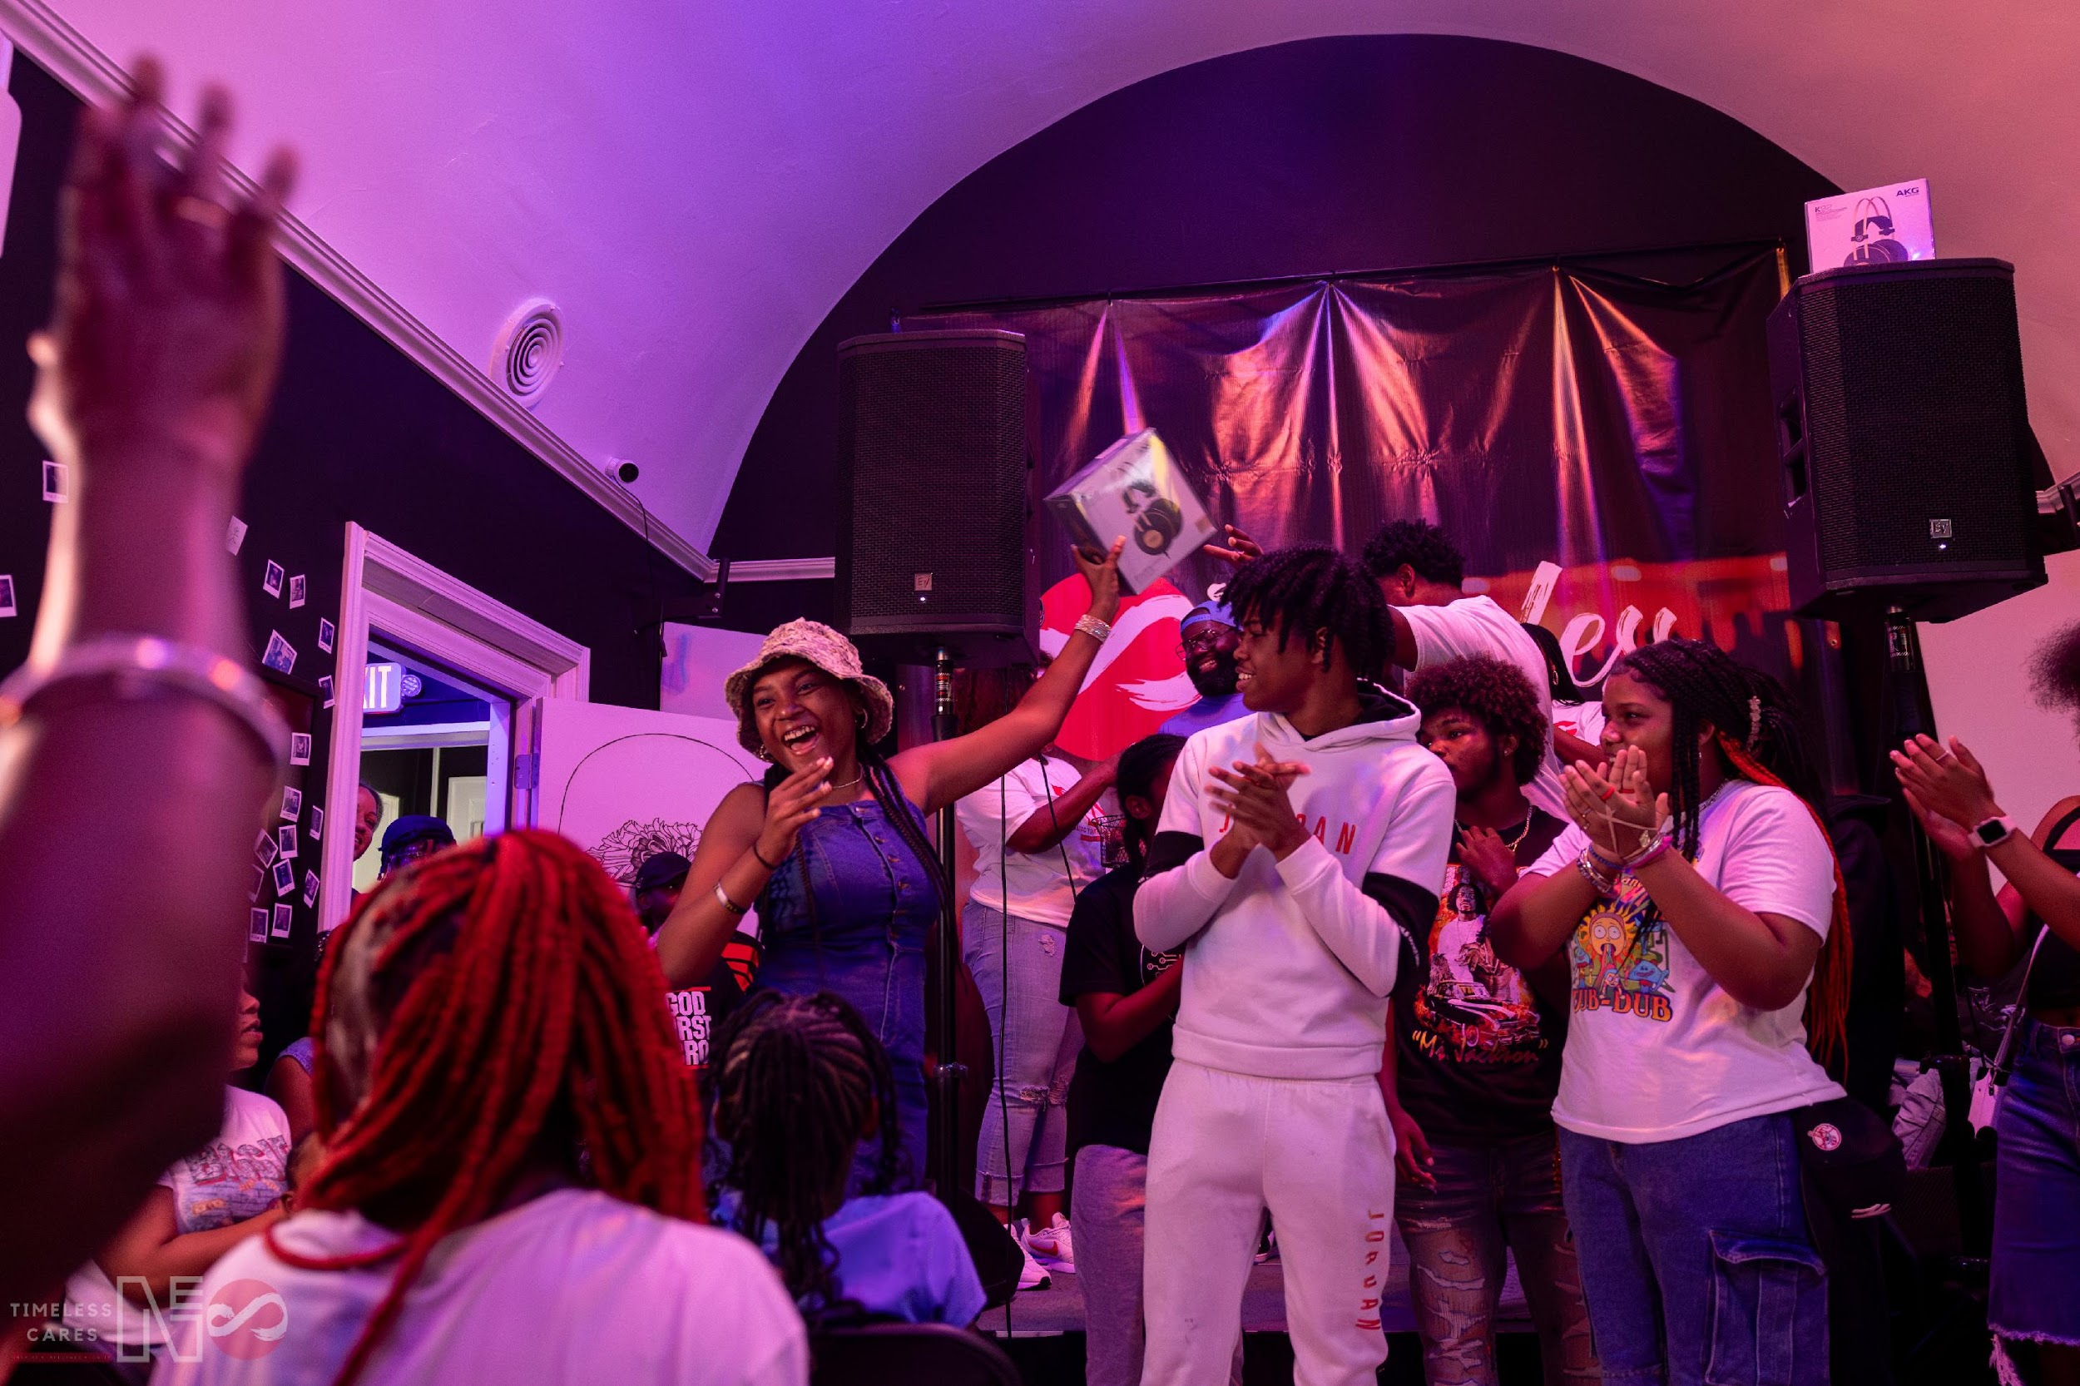
The Safe and Clean Neighborhood Fund was:
Established in 2003 by the City of Cincinnati
Keep Cincinnati Beautiful has been grant administrator since 2007
$500,000 to distribute in FY 2024-2025
3 Grant Cycles per year
Deadlines are 2nd Friday of January, May and September each year
50% of funds will go to Top 10 Neighborhoods experiencing gun violence in Cincinnati’s 52 neighborhoods.
Timeless Cares Studio and Narci Entertainment collaborated to host an Audio Youth Camp for the Summer of 2024. Youth had the opportunity to learn from professionals in songwriting, composing, and recording. Audio Youth Camp created 3 songs that were featured on The Wiz Radio Station.

Slide 5
Priority Focuses for September 2024 cycle:
Engage Youth Leaders: Projects should be led by or actively involve young people who are passionate about improving their neighborhoods.
Promote Physical Changes: Focus on transforming the physical environment, whether it's through litter pick-up, renovations to shared spaces, or creative enhancements to buildings in their area.
Implement Crime Prevention Principles: Utilize Crime Prevention Through Environmental Design (CPTED) strategies to reduce crime and increase community safety.
Enhance Community Ownership: Initiatives should aim to beautify public spaces, fostering a sense of pride and ownership among residents.

Slide 6
Safe and Clean Grant Eligibility:
Project must serve one or more of Cincinnati’s 52 Neighborhoods
Priority focus for organizations serving the Top 10 Neighborhoods with the highest gun statistical violence(by incident): West End, OTR, Westwood, Roselawn, East Price Hill, Avondale, Winton Hills*, CBD/Riverfront*, West Price Hill, Bond Hill*, CUF*
Organizations applying must be in operation for at least 6 months before applying
Project $ amount requested must be over $1,000
Priority focus for organizations that are grassroot and operating budget less than $1 Million
Have met with grant coordinator to discuss project idea and scope of services
Be able to provide a completed W9 if awarded for funding.
* Indicates a 2-way tie
Link to full guidelines here

Slide 7
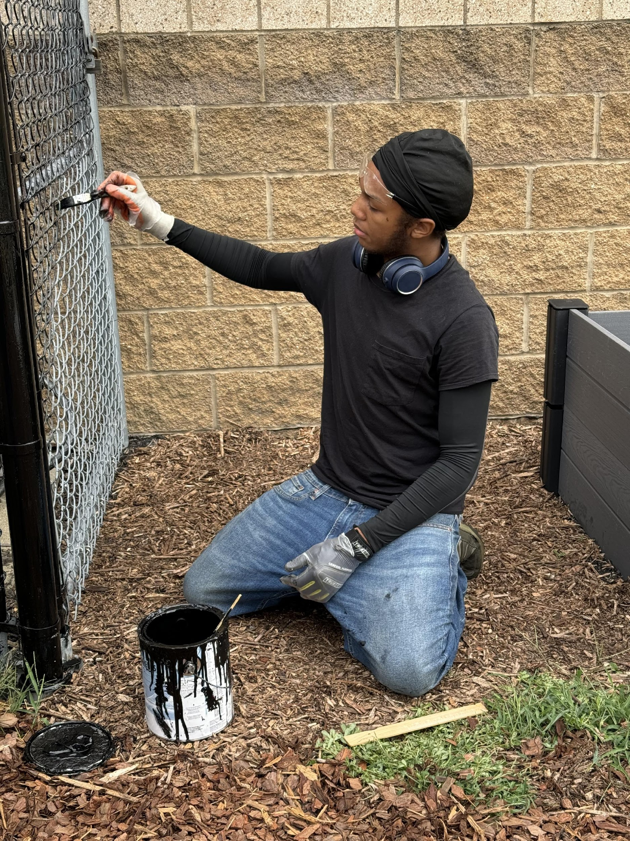
While it's no longer required, projects requesting funds can show evidence of matching funds from the community. This can take the form of volunteer labor, donated materials or professional services, and/or cash.
Fillable budget worksheet is required for application and can be downloaded from our website
Glossary with explained terms of matches and benefit tracking is on our website
Volunteer value per hour is $33.49
Minimum grant award of $1000 with no maximum award.
Average granted amount per project funded in FY 23-24 is $20,833.33
Funds per grant cycle up for awarding average ~ $160,833.33
Price Hill Safety CAT will pay youth to operate lawn mowing tools to beautify vacant lots in Price Hill. Youth will be matched with mentors for training and supervision to include problem solving and budgeting their earnings

Slide 8




INELIGIBLE EXPENSES
Food & Beverages
Entertainment
T shirts / Accessories
Personnel Costs*:
Ongoing payroll
Utility bills: Gas, Electric, Wi-Fi/Internet/Cable
Rent
  *Contractor fees & Service fees are allowed examples: Mural artist, guest speaker, electrician
  Youth Stipends are encouraged
Link to budget worksheet

Slide 9
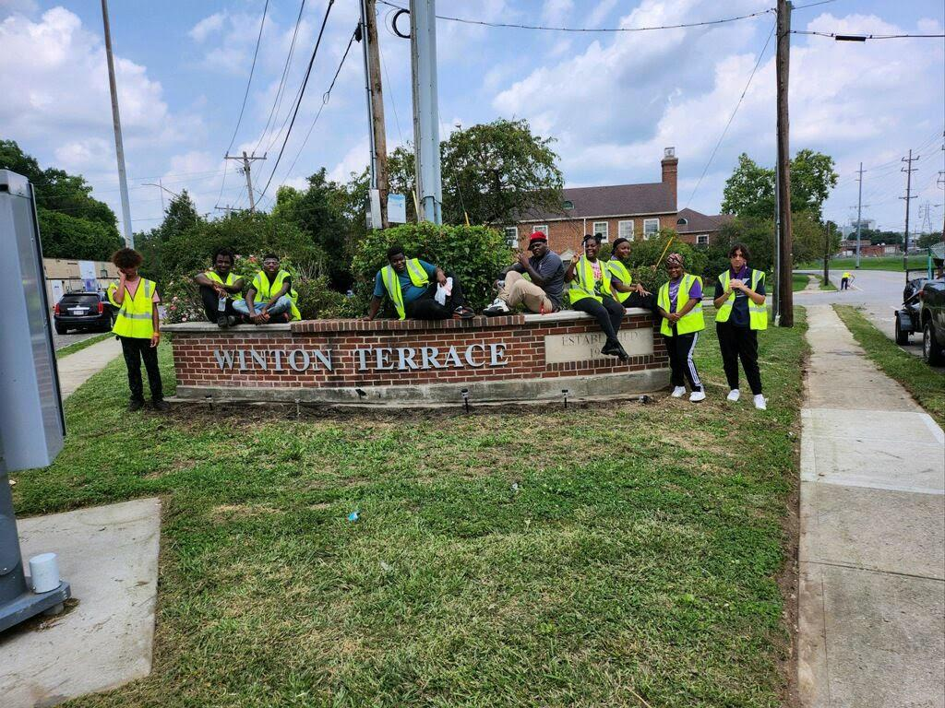
This is a reimbursable grant meaning all expenses, services, materials, & related costs must be paid before submitting for reimbursement.
There are no limits on the number of claim vouchers you submit, you can submit for reimbursement each month, by project area upon completion, or at the end of the project.
KCB has 60 days to pay out reimbursements.
What is not eligible for reimbursement:
T-Shirts, other clothing, Food and Beverages, Entertainment , Ongoing expenses, Personnel Costs(Gas, Electric, overhead costs, payroll)
Note- Stipends/Payment to contractors/services are eligible for reimbursement. Ex: Gun Safety Expert for Gun Violence Prevention Programming.
Save Our Youth Kings and Queens provides after school programming, mentoring, enrichment field trips and stewardship opportunities for youth in the Winton Terrace/Winton Hills community.

Slide 10
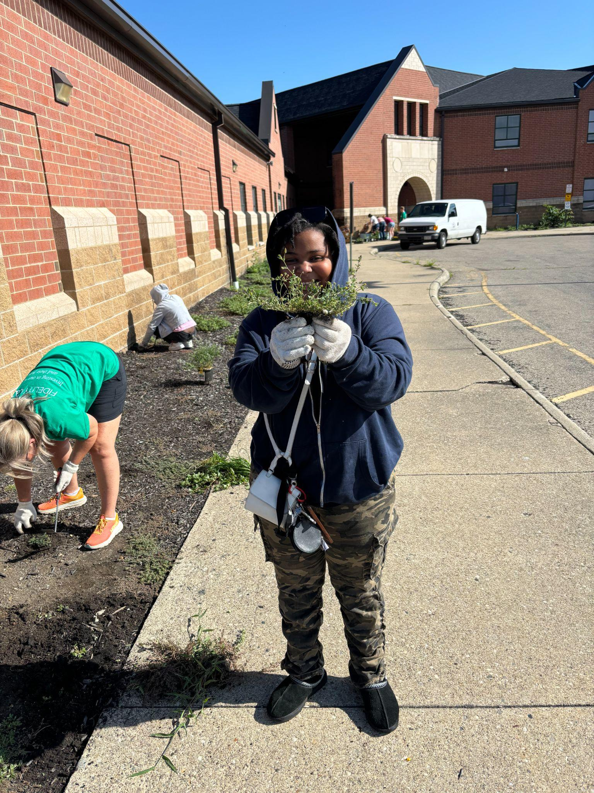
Safe and Clean Grant Term: 1 year term if approved for funding
If the agreement was signed on 6/1/2024 then you’d have until 6/1/2025 make all the purchases necessary for the project that would be eligible for reimbursements.
Midway report is due no later than 7 months after signing agreement with photos/multimedia
Final report is due no later than 30 days after your term ends with photos/multimedia
Failure to submit both reports will disqualify you from receiving funding until both reports are submitted.
Please note: if you have an open grant with S&C, final report must be turned in to be eligible for the next deadline. Can not have more than one open grant.
Youth member of Boys and Girls Club of Greater Cincinnati at Rees E. Price Elementary weeding and installing new flower beds

Slide 11
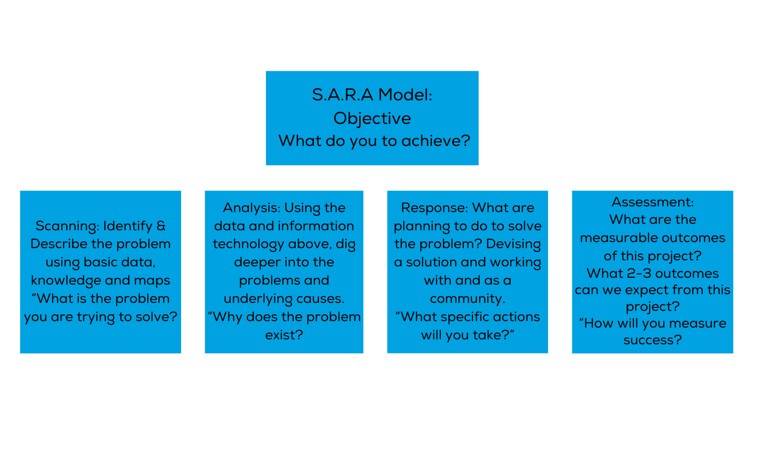
SARA MODEL
Link to SARA Model SARA Training Alerts & Reminders

Slide 12
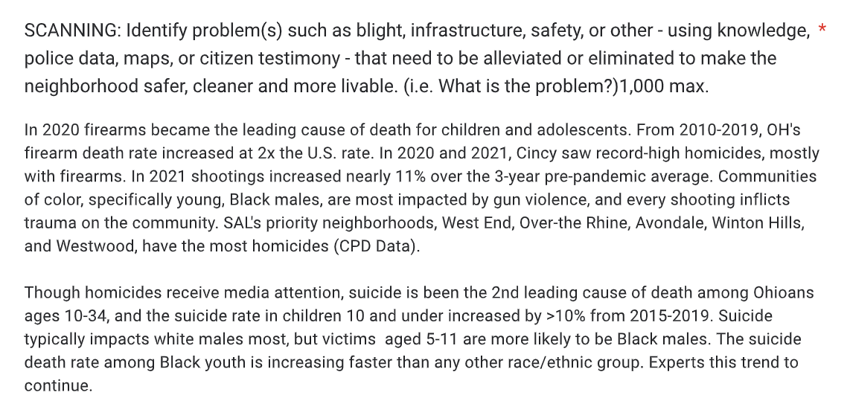
Clear on what the problem is and sites data source.

Slide 13
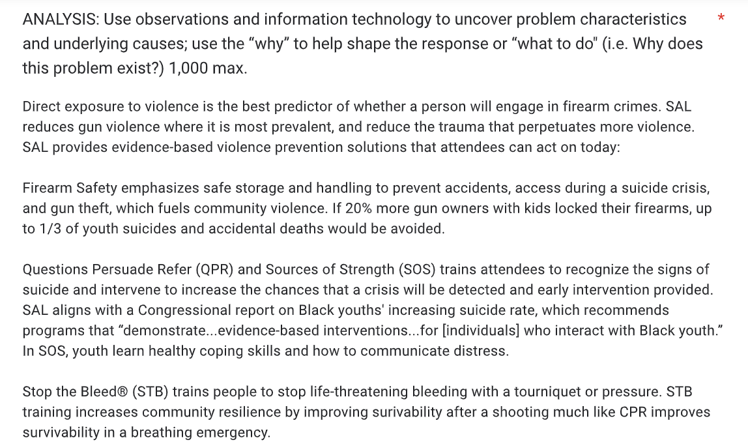
the “why”
Answers “why” the problem exists
Answers what to do

Slide 14
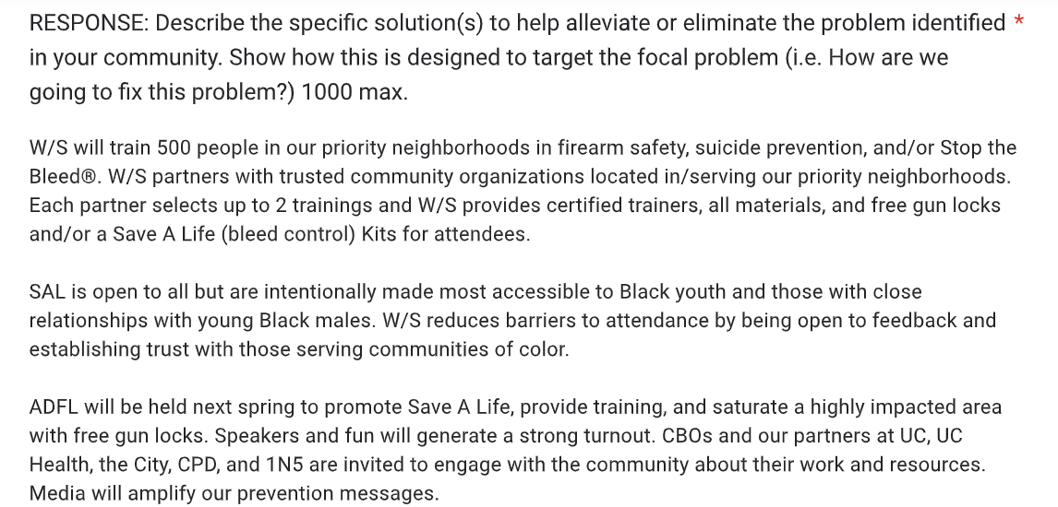
Answering: Who, What, When, Where, How

Slide 15
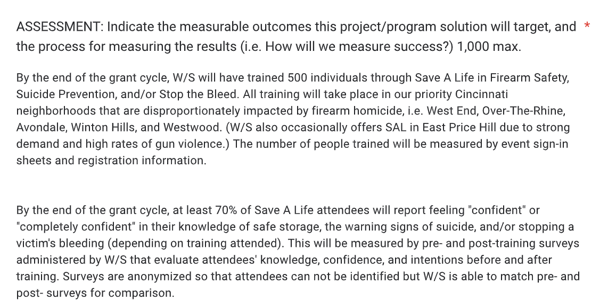
Measurable outcomes with how they will be measured

Slide 16
Feedback from application example:
The application was straightforward and to the point.
Scanning- Need to cite sources.
Analysis- Able to identify the why, could have included more narrative when talking about direct exposure to gun violence with storage rates. Is it the lack of education of gun safety?
Response- Who, What, When, Where, How, Why- provided good details and directly how they were going to solve in the scanning section.
Assessment- Add another metric: this would include post-grant term follow-up, post 6 months, check-in with participants.
General thoughts to be thinking: How will you know your project will be successful?

Slide 17
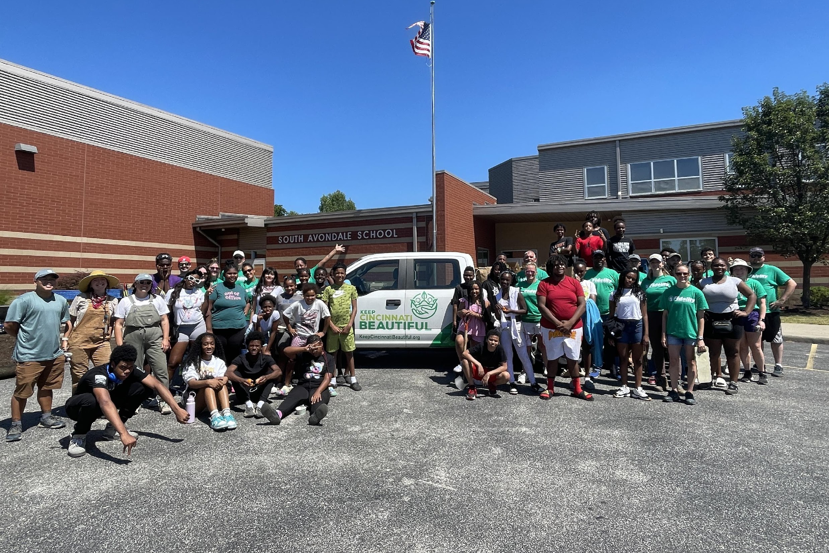
Measurable Outcomes
Boys and Girls Club of Greater Cincinnati's measurable outcomes:
Host two 2024 summer clean-up volunteer opportunities (40-50 BGCGC teens participating in two 3-hour events). Teens work alongside community volunteers (Fidelity and KCB) in Avondale and Price Hill – neighborhoods
that experience litter, over growth and invasives.
Long-term, these activities will continue to build safety, as at least 75% of
summer campers continue as year-round Club members. Additionally,
BGCGC teens will visit clean-ups sites monthly year-round, further building
community pride.
Keep Cincinnati Beautiful's Education and Youth Programming Team with Boys and Girls Club of Greater Cincinnati and Fidelity at South Avondale Elementary in July 2024

Slide 18
Measurable Outcomes Cont.
Boys and Girls Club of Greater Cincinnati's May 2024 Grant: $9,167
Host two 2024 summer clean-up volunteer opportunities (40-50 BGCGC teens participating in two 3-hour events). Teens work alongside community volunteers (Fidelity and KCB) in Avondale and Price Hill – neighborhoods that experience litter, over growth and invasives.
Long-term, these activities will continue to build safety, as at least 75% of summer campers continue as year-round Club members. Additionally, BGCGC teens will visit clean-ups sites monthly year-round, further building community pride.
Feedback:
Great use of SMART Goals: Specific, Measurable, Achievable, Relevant, Time-Based
Set a goal for year round monthly clean ups, "we aim to complete 12 monthly clean ups for 2 hours each visit with 6 bags of trash collected each visit for the next 12 months."

Slide 19
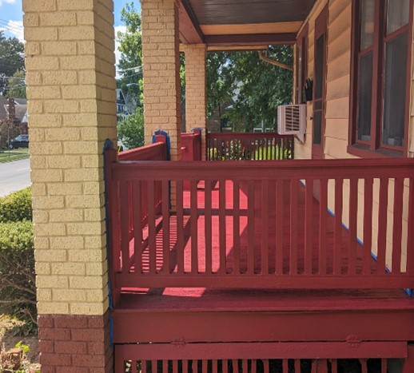
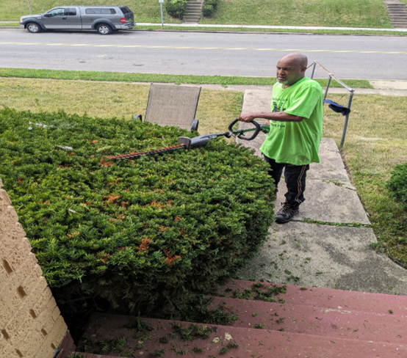
Madisonville Mission Ministries’ Flash Point Project
Provide minor home repairs and updates to low-moderate income residents in Madisonville/Kennedy Heights, Madisonville Mission Ministries collaborated with Mentoring Young Men Ministry to complete the projects.
With 13 young men from the communities, they were able to complete 7 household repairs and updates totaling 507 hours of volunteer sessions.
Each youth participant was able to receive a stipend for their time.
“The impact of this program has made noticeable changes in our community. Because of our efforts, some property owners took action on their own to remove trash that was present.”
“Property owners are offering us to help with these efforts to ensure property owners are taking care of their properties.”
Madisonville Mission Ministries received $15,225 for Safe and Clean Funds including paying for youth stipends.

Slide 20
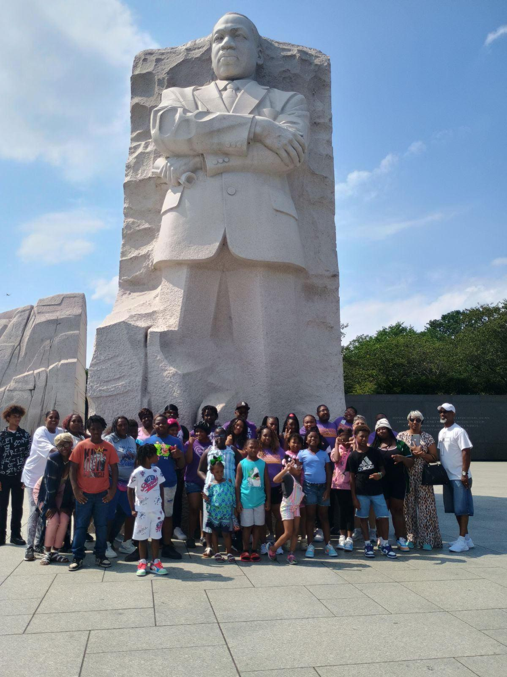
Price Hill Safety CAT(Community Action Team): May 2024 Grantees $2,832.56
Summary of project: Our proposed project concentrates on improving safety, eliminating blight, and provides youth job opportunities in Price Hill. Youth will operate lawnmowers, weed eaters, and hedge trimmers to beautify vacant lots or properties. Mentors train the students how to use the equipment and guide them in problem solving, banking and goal setting. Previous participants work with current youth to promote pride in Price Hill. Our proposed funds will be used to purchase hedge trimmers, gloves, garbage bags, brooms, rakes, dust pans, and weed eater string. When we meet with youth in the community, we also provide school supplies, hygiene gift cards, and backpacks to kids.
Assessment/measurable outcomes:
The Price Hill Safety CAT aims to
Clean two to three lots every Saturday (40-60 areas) and work 20 weeks, June through October.
By the end of October, six to ten youth will be able to operate the various outdoor equipment, work as a team, take pride in their work and dispose of yard waste/debris properly,
80% of youth will be able to access a bank account and save for their future.
Our goal is for 80% of the youth to work the entire 20 weeks and remove at least 100 bags of debris.
Youth and mentors will complete surveys regarding what worked and could be improved. If we meet these goals, and have students return the following years, we will consider this even more successful. This year, 5 kids will be returning from past years.

Slide 21
Tips when writing your application:
Imagine your application is being read for the first time. Does it make sense? Are all the logistical pieces in place(examples: location of project, transportation)? I may have read your proposal, but the committee has not.
Cite your references.
K.I.S.S- Keep It Short and Sweet, sometimes less is better(not to say to leave out important details but less narrative and straight to the point).
If your project includes other city departments, please make sure you’ve received the information needed from the department before applying. ex. invoice/bid from DOTE, DPS, etc. Please inform Ty if your project includes another department before submitting your proposal.
When measuring assessment and outcomes think of S.M.A.R.T
  Is it specific?
Is it measurable? Can this goal be used as a metric/number/data?
Is it achievable?
Is it relevant to Safe and Clean’s focus and the mission of Safe and Clean?
Is this goal time-based within the year term limit?

Slide 22
How are Safe and Clean applications reviewed?
Keep Cincinnati Beautiful will convene a six-member Fund Advisory Committee to review grant applications and make recommendations for funding. Composition of the Fund Advisory Committee will be as follows:
One representative from Keep Cincinnati Beautiful; this representative will also serve as the Fund Advisory Committee’s convener(NON-VOTING)
One representative from Community Development and Planning
One representative from the Police Department
One representative from the City Manager’s office (ex officio member)
One representative from Public Services
One member from the private sector (representing a broad cross-section of the community) selected by Keep Cincinnati Beautiful
In the case of resignation or removal of a representative, Keep Cincinnati Beautiful will replace the representative in time to participate in the upcoming round of application reviews and recommendations.

Slide 23
SAFE & CLEAN APPLICATION DEADLINES
Timeline | Important Dates
Applications go live | 30 days before deadline
Initial meeting with coordinator to discuss project(required) | 10 days before deadline
Request for feedback | 5 days before deadline
Safe and Clean Grant Application Deadline | 2nd Friday in January 2nd Friday in May 2nd Friday in September
Grant Award Notification | Within 30 days of application deadline
Midway Report | Halfway through project completion or within 7 months of award
Final Report | Due at the end of project completion

Slide 24
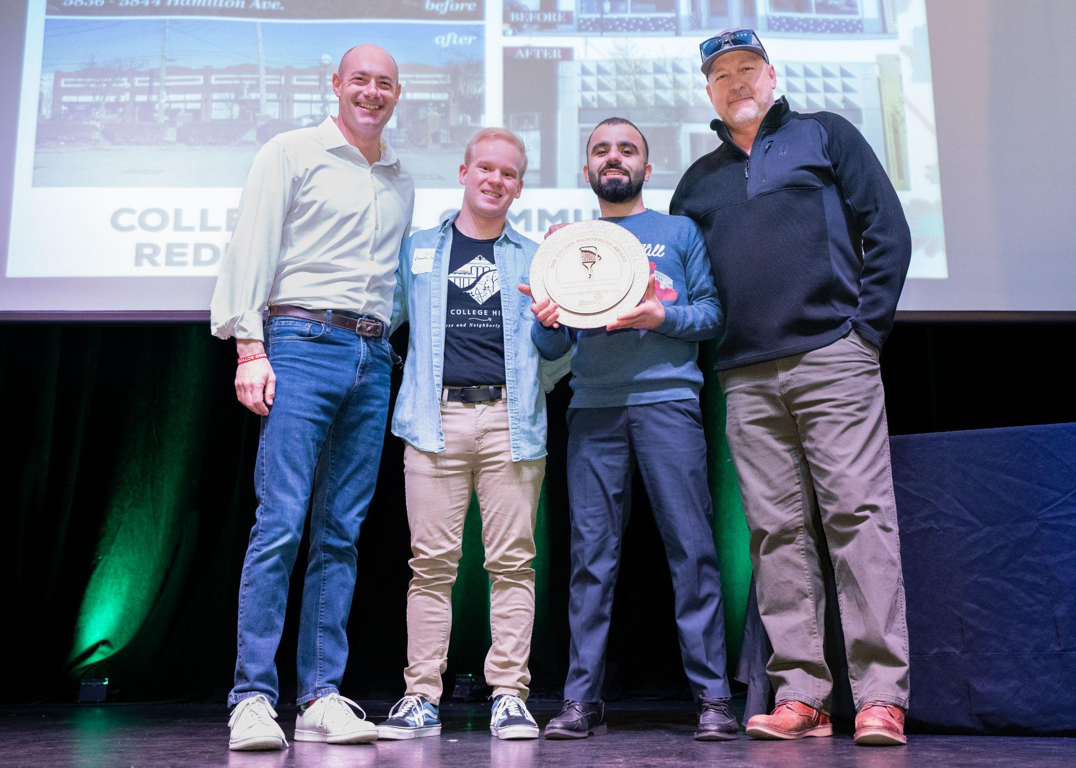
Next steps to apply for Safe and Clean Funding:
Review full guidelines here.
Reach out to Ty to discuss your project/program proposal at Ty@Keepcincinnatibeautiful.org - you must meet with Ty to be eligible for funding.
  Please note attending/watching the virtual informational session(s) does not qualify for a meeting.
Applications open 30 days prior to deadline via Submittable(link will be on the website)
We will notify you on your application status no later than 30 days after the deadline.
Application Feedback is offered to applicants regardless if accepted for funding or declined at this time.
Greg Landsman with members of College Hill Urban Redevelopment Corporation(CHCURC, current S&C grantee) at Keep Cincinnati Beautiful’s 2024 Love Thy ‘Nati Awards.

Slide 25
Grant Application Writing Resources:
Please do not hesitate to reach out to me if you have questions, need further assistance or accommodations. I am willing to review your drafted proposal and give feedback before submission deadlines. Please send feedback/application review requests no later than 5 days before the application deadline. Please send questions to Ty Wesselkamper: ty@keepcincinnatibeautiful.org
UC Grant writing - online classes via ED2go
Cincinnati State also offers online courses via ED2go
Cincinnati Public Library: Free Resources/Classes/Workshops
Greater Cincinnati Foundation: Resources, Data, Capacity Building guides
-Grammarly - Free AI proofreading application
- Linkedin Grant Writing Webinars
City of Cincinnati- OPDA(office of performance and data analytics) - Free for public, Cincy Insights is also a good tool via ODPA.
University of Cincinnati Grant Writing Resources- Ebooks, Web Resources
Grants Plus Resources: They also offer services for non-profits, webinars, articles, etc.

Slide 26

QUESTIONS?
Please note it is required to meet with Safe and Clean Grant Coordinator to be eligible for funding.
To learn more about Safe and Clean Funding please visit
our website here
Ty Wesselkamper
Safe and Clean Grant Coordinator
ty@keepcincinnatibeautiful.org

